Slide 1

Credit Card Approvals
Final Project CIS 546
Ana Pacella

Slide 2
Data
Dataset from Kaggle
https://www.kaggle.com/datasets/samuelcortinhas/credit-card-approval-clean-data

Slide 3
Naive Bayes Model
Created model
Made predictions
Confusion matrix
Accuracy: 0.83

Slide 4
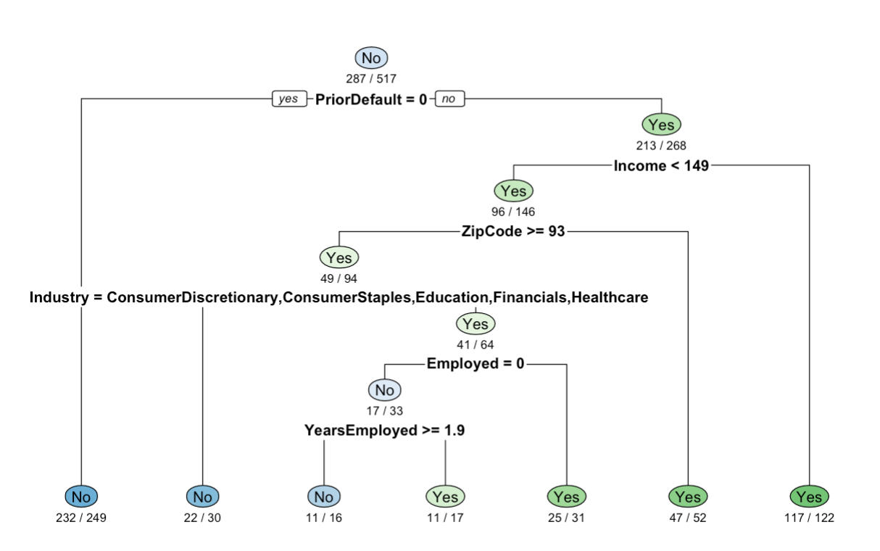
Decision Tree Model
CART Tree Model
0.83 accuracy

Slide 5
Shiny App & Tableau Dashboards

